Slide 1
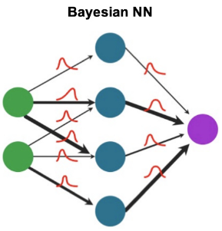
Uncertainty-Aware Neural Networks: BNNs
Orion Foo
Notes:
Notes:
First run: 30 minutes
Add

Slide 2
Talk Outline
Approach and general overview
Methodology
Tasks
Extensions
Uncertainty on vanilla MNIST
Adversarial Testing/Training
Regression
Results
https://foolbox.jonasrauber.de/
To modify your model and training code for a regression task, several key changes are needed:
Output Layer: The final layer of the model should have a single output neuron (for a single-target regression task) or as many neurons as the number of targets you're predicting.
Loss Function: Instead of CrossEntropyLoss, which is used for classification, you should use a regression-appropriate loss function like Mean Squared Error (nn.MSELoss).
Data Preparation: Ensure that your target data (y_train and y_test) is appropriate for regression (i.e., continuous values, not class labels).
Evaluation Metric: Replace accuracy calculation with a regression metric, such as Mean Absolute Error or Root Mean Squared Error.
Notes:
Consider using colors for important points on slides

Slide 3

Approach
PyTorch backend
Problem statement - implementing custom NN layer
Understanding BNNs
Weights are distributions rather than fixed scalars
Uncertainty
Stochastic Sampling
Reparameterization Trick
Understanding data set
MNIST
Input size, output size
Classification task
Loss function, output, etc.

Slide 4
Task #1

Slide 5

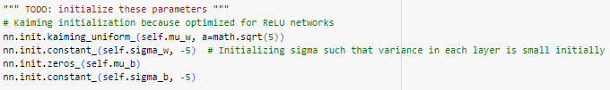
Implementing ‘LinearBayesian’ class (1)
Task: Defining linear layer with Bayesian properties
init(self, size_in, size_out):
Inheritance relation between Bayesian layer and Linear layer
super().__init()__()
Defining new learnable parameters of a Bayesian Layer
Initializing parameters
Kaiming maintains scale of gradients; helps with vanishing/exploding gradients
Potential for optimization (https://arxiv.org/abs/1502.01852)?
Notes:
This initialization method is designed to maintain the scale of the gradients approximately the same in all layers, which helps in keeping the signal from vanishing or exploding during forward and backward passes in deep networks.

Slide 6
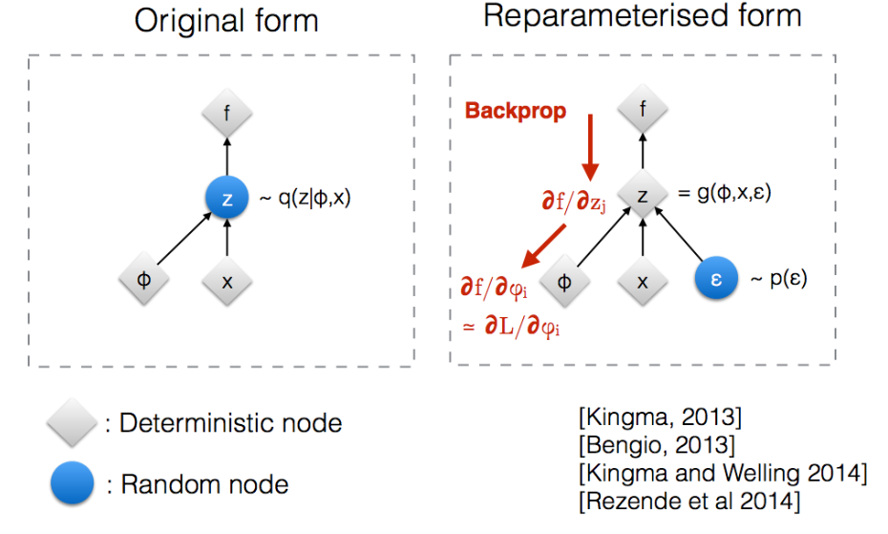

Implementing ‘LinearBayesian’ class (2)
forward(self, x):
Reparameterization trick
Used for VAEs
Backprop cannot flow through distributions (random nodes)
Consider a weight W in a BNN, where
How to take gradient with respect to mu, sigma?
Reparametrization:
Notes:
In a Bayesian neural network, weights are not fixed values but are instead drawn from probability distributions. When performing forward passes through the network, we sample weights from these distributions. However, directly sampling weights and then computing the loss (and subsequently gradients) poses a problem: the randomness introduced by direct sampling breaks the gradient flow, making it impossible to use standard backpropagation.
The reparameterization trick solves this problem by re-expressing the random variable in a way that separates the stochasticity from the parameters we want to optimize. Instead of sampling the weights directly, the trick involves sampling from a standard distribution (like a standard normal distribution) and then transforming these samples deterministically using parameters of the model. Epsilon is random noise sampled from random distribution, allows for deterministic W

Slide 7
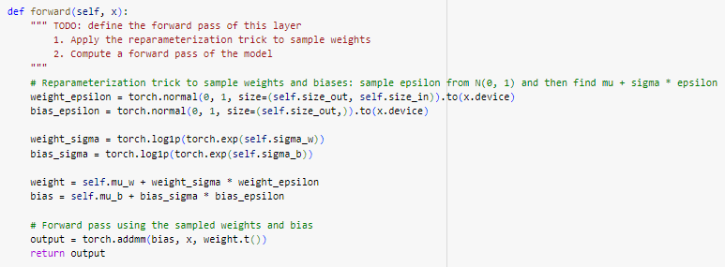
Sequential(
(0): Flatten(start_dim=1, end_dim=-1)
(1): LinearBayesian()
(2): ReLU()
(3): LinearBayesian()
(4): ReLU()
(5): LinearBayesian()
)

Slide 8
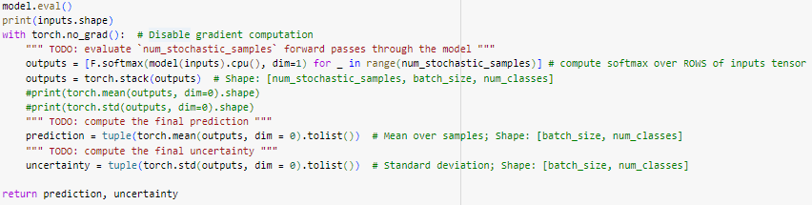
Implementing ‘predict_with_uncertainty’
Task: Perform multiple forward passes through the NN and compute prediction/uncertainty
Stochastically sample from distributions for weight values
Perform ‘num_stochastic_samples’ forward passes through the model
Apply softmax to each output to get probabilities
Calculate mean (prediction) and standard deviation (uncertainty)

Slide 9
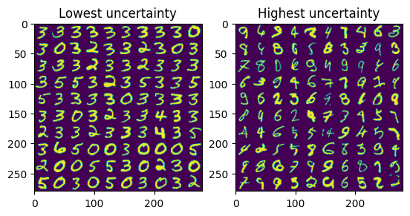
Visualizing Model Uncertainty
Uncertainty makes sense!

Slide 10
Task #2

Slide 11
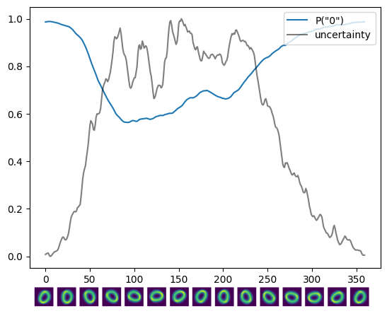
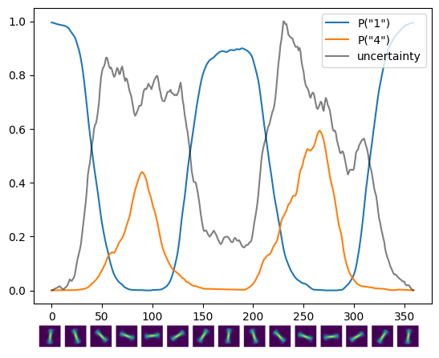
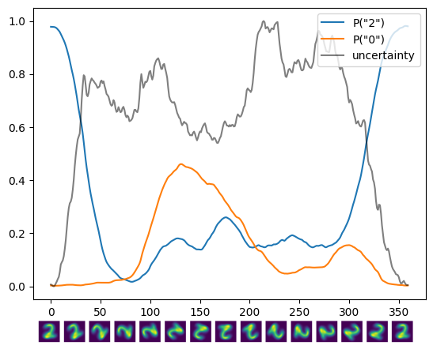
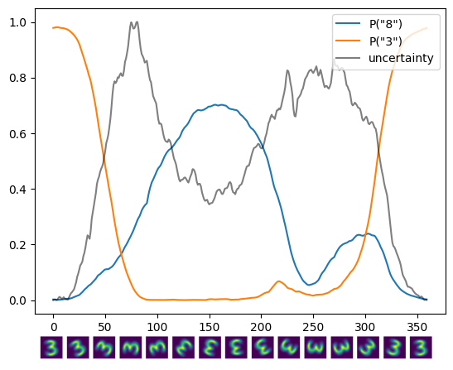
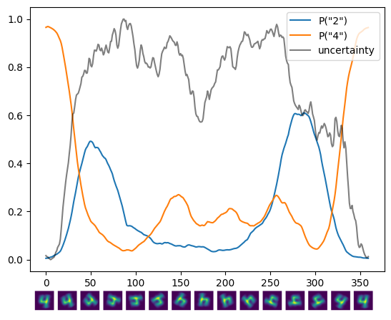
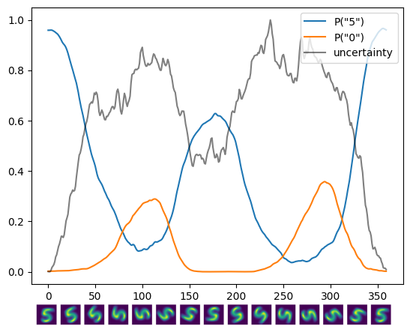
Testing on OOD examples from MNIST
Comparing between the performance of the trained BNN on all digits adversarially by rotating images:

Slide 12
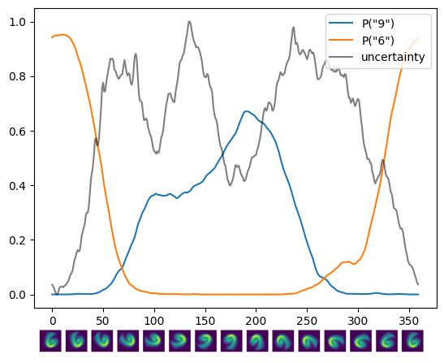
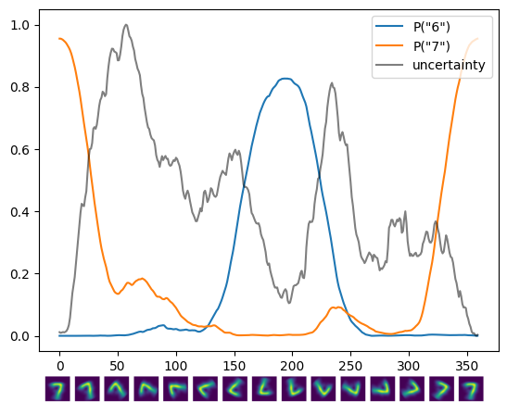
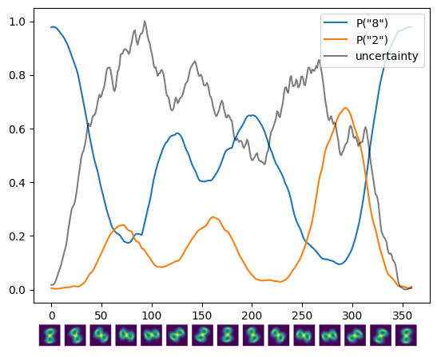
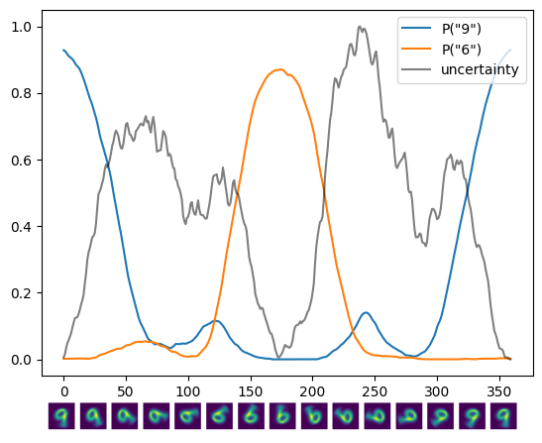

Slide 13
Extensions

Slide 14

Adversarial Attacks
Testing model performance against all rotated digits
Previous slides
Foolbox: https://github.com/bethgelab/foolbox
Implements various adversarial attacks within Python
https://foolbox.readthedocs.io/en/stable/modules/attacks.html#foolbox.attacks.LinfProjectedGradientDescentAttack
PGD, Inversion, FG, FGSM, etc.
Procedure for testing model performance on adversarial datasets:
Generate adversarial examples (train/test)
Run stochastic inference and compute predictions and uncertainty
Analyze and visualize performance
Train on adversarial data + inference (repeat 2,3)
Test trained model on new OOD attack

Slide 15
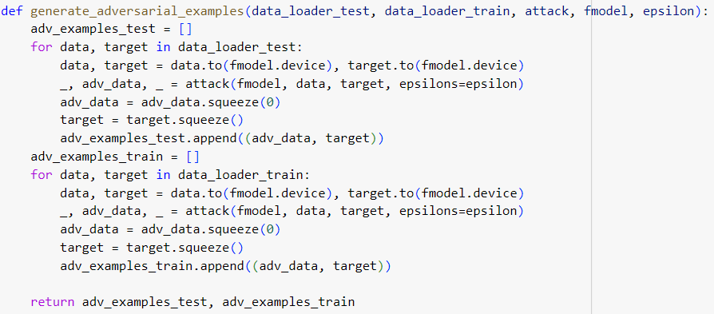
Implementing ‘generate_adversarial_examples”
Convert PyTorch → Foolbox model + instantiate FGSM attack
Using MNIST dataloader, load in data and feed into Foolbox attack() function
Important to specify ε: perturbation size
Generate test and training data

Slide 16
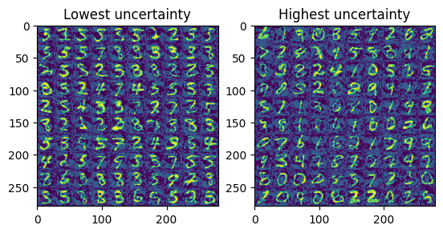
Running Predictions and Visualizing Adv. Data

Slide 17
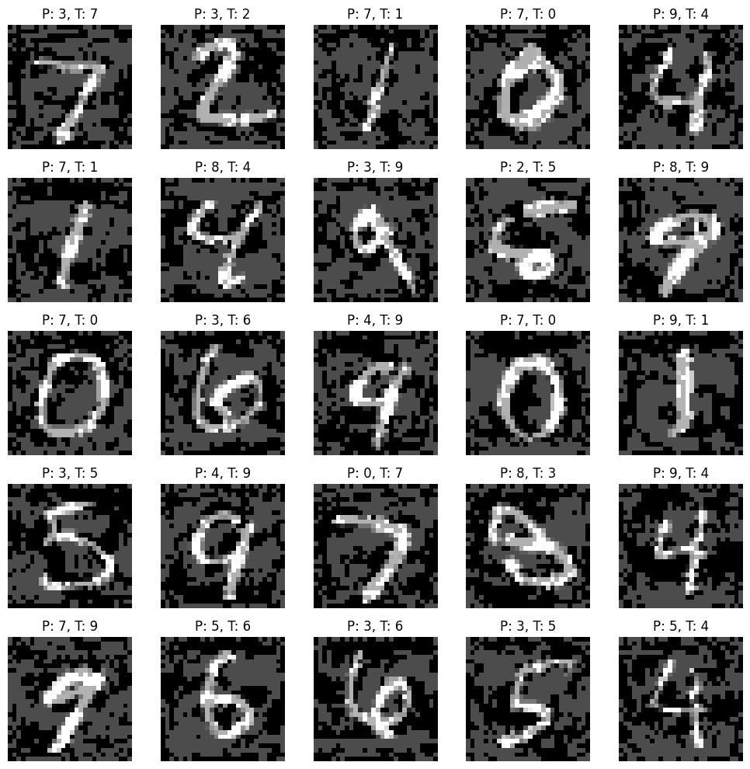
Accuracy on adversarial testing set without training: 1.58%

Slide 18
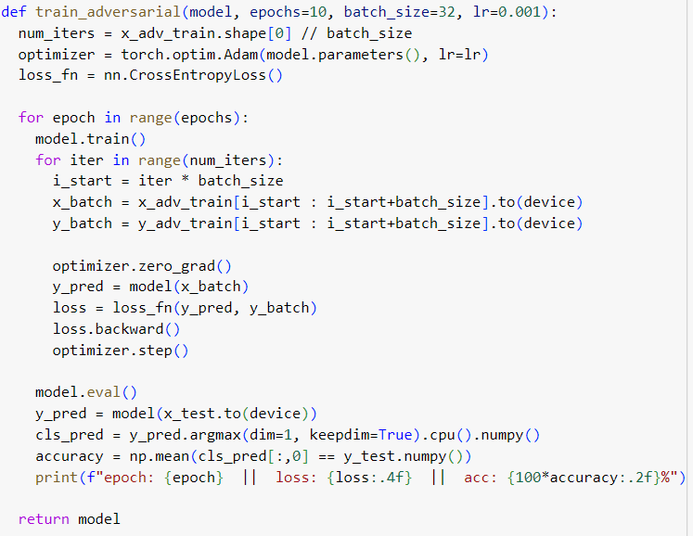
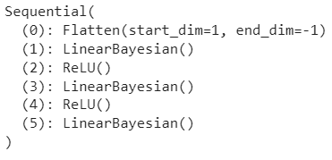
Training on Adversarial Data
Same structure + architecture as training for LinearLayer and BayesianLayer
Training data + test data generated from generate_adversarial_examples() with ε = 0.3

Slide 19
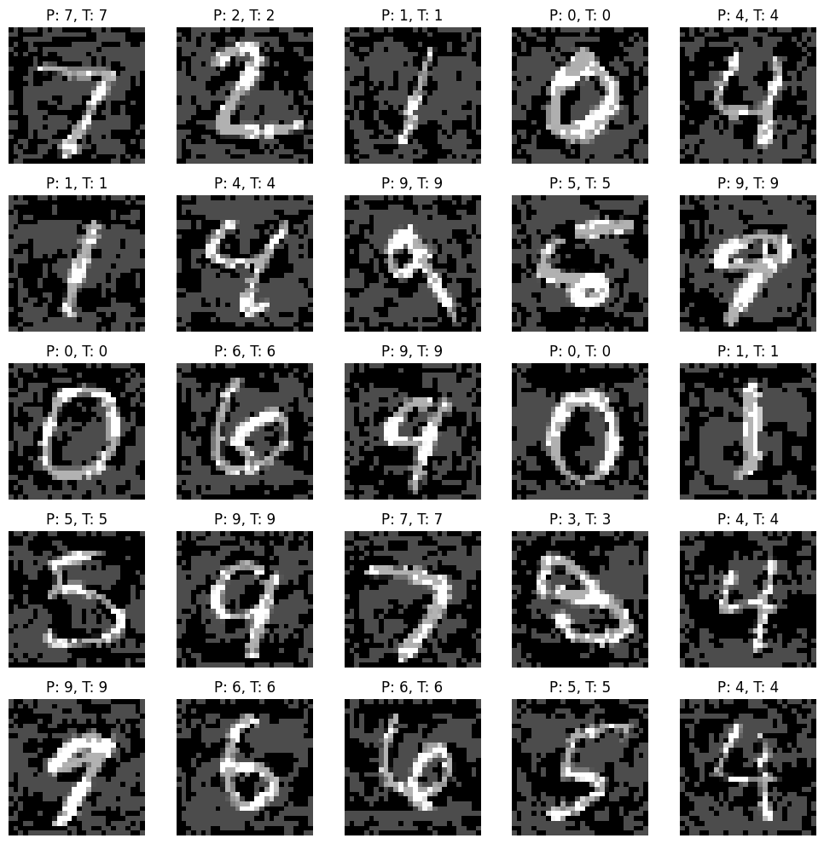
Visualization with Predicted Labels and True Labels
Accuracy on adversarial testing set without training: 99.1%

Slide 20
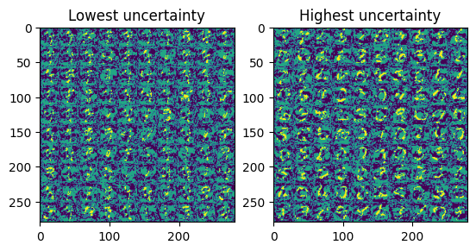
Testing Trained Model on OOD Attack
Generating new OOD Attack using FGSM but with ε = 0.6
Perturbs the input images twice as much

Slide 21
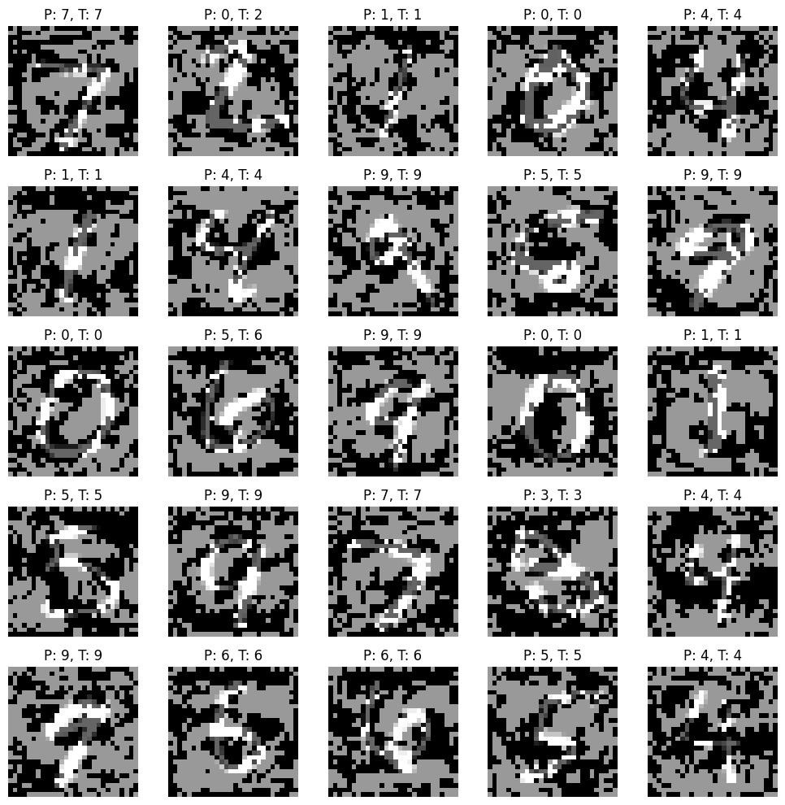
Accuracy on adversarial testing set without training: 93.98%
Notes:
As we can see, the accuracy of the adversarial model trained on ϵ=0.3 still performs relatively fine on OOD inputs with more noise/perturbations added!

Slide 22
BNNs on Continuous Regression Problems
Necessary components/changes:
Output Layer: should have 1 output neuron (for a single-target regression task) as opposed to 10
Loss Function: Instead of CrossEntropyLoss, which is used for classification, should use regression-appropriate loss function (MSE)
Data: Need appropriate test/training data suitable from regression
Evaluation Metric: Replace accuracy calculation with MAE

Slide 23
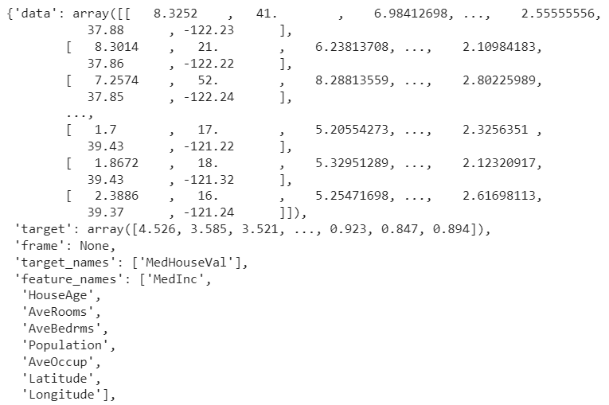
BNNs on Continuous Regression Problems
Necessary components:
Regression Dataset for test set and training set
California Housing Dataset from sklearn

Slide 24
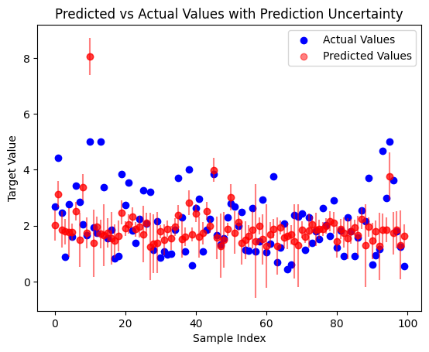
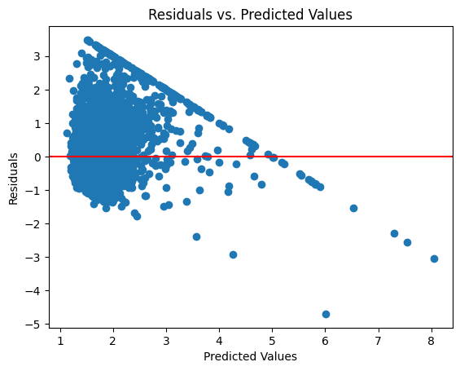
Visualizing Results
After training model:
MAE: 0.726

